Slide 1



Healthcare Assistant for Chest Cancer with AI
Tulsiramji Gaikwad Patil College Of Engineering
& Technology
Team Member’s:-
Arvind Dhage
Sushant Namurte
Urmal Chide
Vaibhav Durge
Urmal Chide
Vaibhav Durge

Slide 2

Problem Statement
Brief Overview :
The early detection and accurate diagnosis of chest cancers, such as lung cancer, remain significant challenges in the field of oncology. These cancers are often diagnosed in advanced stages due to the lack of noticeable symptoms in early stages, leading to poor prognosis and limited treatment options. Radiologists and healthcare professionals are overwhelmed with a growing volume of diagnostic imaging data, making it difficult to provide timely, accurate assessments for all patients. Furthermore, interpreting these images is time-consuming and prone to human error, leading to potential delays in diagnosis and treatment..
Key Objectives :
Early Detection
Diagnosis Support
Efficiency
Patient Prioritization
Outcome Improvement

Slide 3
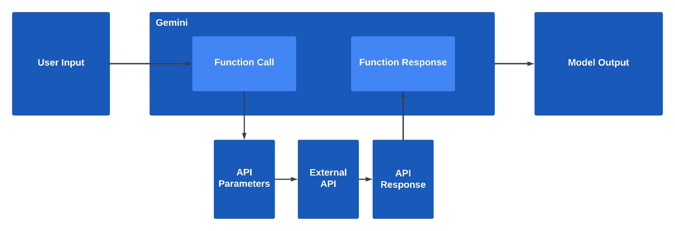

Dataset Overview(Optional)
Dataset Description:

Slide 4

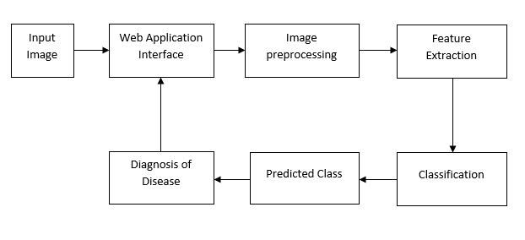
Methodology
Approach :
Algorithms Used :
Convolutional Neural Networks : CNNs excel at detecting patterns, shapes, and features in medical images such as tumors, lesions, and abnormal tissue. They can identify cancerous areas by learning features like size, texture, and location.
Random Forest : Random Forests are robust and can handle large datasets with mixed types of features (numerical, categorical). They are useful for classifying patients based on risk (high, medium, low) by taking multiple variables into account.
Clustering Algorithms (e.g., K-Means) : Clustering can help identify subgroups of patients who respond similarly to treatment, aiding in precision medicine and tailored treatment approaches.

Slide 5

Conclusion
Summary:
This case study showcases this AI Chest Cancer Assistant represents a significant advancement in medical technology. By leveraging cutting-edge ML/AI algorithms, it provides robust, accurate, and efficient diagnostic support. The system not only assists radiologists in identifying cancer but also helps in risk stratification and follow-up care, improving overall patient outcomes. This technology has the potential to greatly reduce human error, speed up the diagnosis process, and save lives by detecting cancers at earlier stages, ultimately transforming the field of technology.
Future Work:
Future work on the AI Chest Cancer Assistant should focus on improving its scope, transparency, personalization, and accessibility. With advancements in multimodal learning, explainability, and integration with clinical systems, the assistant has the potential to evolve into a comprehensive, widely accepted tool in global healthcare

Slide 6
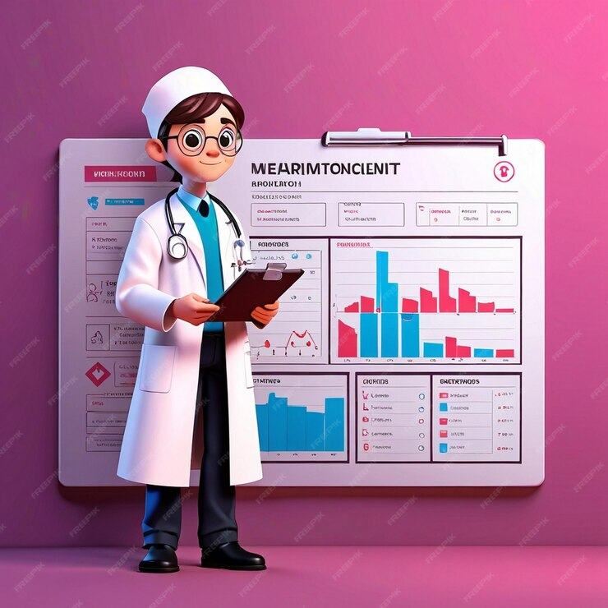
References
https://arxiv.org/pdf/2304.04814
https://www.analyticsvidhya.com/blog/2021/10/understanding-transfer-learning-for-deep-learning/
https://keras.io/api/applications/vgg/#vgg16-function
https://my.clevelandclinic.org/health/diseases/3986-breast-cancer
https://ai.google.dev/

Slide 7
Thank You
Notes:
Thank You !!

